Slide 1
Written by Gábor Mihalec
Department of Family Ministries
Hungary Union Conference

Slide 2
Hungarian architect, Ernő Rubik invented this toy in 1974

Slide 3
Marriage
Some have found that marriage did not work
Others are living examples that it can!
It is possible to live happily and faithfully!

Slide 4
Proverbs 5:18-19
“May your fountain be blessed,
and may you rejoice in the wife of your youth. A loving doe, a graceful deer—may her
breasts satisfy you always, may you ever
be intoxicated with her love”.

Slide 5
Infidelity Pattern
There are different stages most couples go through who end up in infidelity. It is a phenomena that is explainable and even predictable.
If something is explainable and predictable, that means it also can be preventable.
Infidelity is preventable from even becoming a consideration in the mind of either spouse.

Slide 6
Steps that can help you to deepen your level of intimacy:
Define your relationship
Who are you?
What are you expecting from each other?
Who are you to each other?

Slide 7
When Dating you might say:
“We consider ourselves a dating couple and our goal is to get to know each other more in order to decide how to continue our relationship.”
When engaged you might say:
"We are an engaged couple who have made a decision that we want to continue life together."

Slide 8
If you are married you might say:
“We are a married couple, and we have committed ourselves to a long-term, monogamous relationship where we open up all areas of our lives to each other. We will show trust and loyalty to each other and continuously work together on a shared life journey.”

Slide 9
Definition of Marriage
Marriage is the voluntary, monogamous, life-sharing union of one man and one woman, based on equality, mutual love and commitment, protected by law, and made with the intention of lifelong commitment.

Slide 10
Exercise:
Discuss as a couple how the different elements of the marriage definition describe your relationship.

Slide 11
Steps to deepen your intimacy
Define your relationship
Mark and protect the boundaries of your relationship
In a marriage two individuals create a new form of life, a new companionship (WE)
It is time to put others aside and start to focus on each other.
We must treat our spouse as “the only one for us”, leaving the “search phase” behind.

Slide 12
Border Protection
Avoid being alone with the opposite sex
Avoid situations where you would need to travel alone with the opposite sex in a car
Avoid physical contact
Instead of greeting with a hug or kiss, offer a handshake from an appropriate distance.
Make it clear to everyone that you have a happy marriage

Slide 13
Exercise:
What does border protection mean in your life, and in your profession?

Slide 14
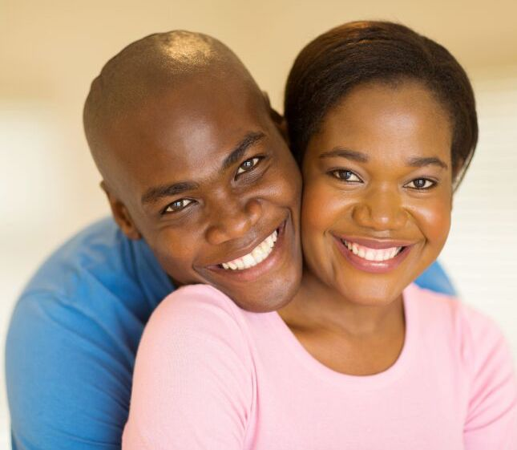
Steps to deepen your intimacy
Define your relationship
Mark and protect the boundaries of your relationship
Give 100%
In order to achieve good results in your marriage, you need to work on it intentionally
Take part in marriage retreats, reading good books, and making time for each other

Slide 15
Give 100%
You cannot take halfheartedly something that you expect to be one of the most important things in your life
You can’t be a spectator in your own life, and certainly not in your marriage!
Be intentional! We cannot get the best out of our marriage unless we are intentional.

Slide 16
Exercise:
What are the things that you can intentionally invest is the growth of your relationship?
List at least 10 ideas

Slide 17
Steps to deepen your intimacy
Define your relationship
Mark and protect the boundaries of your relationship
Give 100%
Foster the atmosphere of trust in your marriage

Slide 18
What do we need in order to learn to trust someone?
Cultivate a culture of respect and admiration
Don't live together with "scrappy" things
Resolve the conflicts that can be resolved
Develop a glass pocket and glass heart
Exercise positive fidelity
Do things together just for the sake of being together

Slide 19
Steps to deepen your intimacy
Define your relationship
Mark and protect the boundaries of your relationship
Give 100%
Foster the atmosphere of trust in your marriage
Talk! Talk! Talk!

Slide 20
Talk! Talk! Talk!
If a couple are to communicate on the deeper levels of their relationship, they have to find a way to communicate intimately
An intimate discussion is an entry ticket into the inner world of our partner
Have conversations that assure our spouse
that we are listening
that we are really interested

Slide 21
Talk! Talk! Talk!
Noted marriage researcher Dr. John Gottman gives us a four-step guide on how to achieve this:
Articulate your feelings with “I” statements
Ask open-ended questions
Deepen your partner's expressions
Express your sympathy

Slide 22
Express your sympathy
The following will help to keep a conversation flowing and make it deeper:
- I can see that this is really hurting you
- It hurts me too to hear what you are saying
- No wonder you became angry
- If someone said this to me, I would be hurt too
- Oh, my dear, this must have been really bad for you
- This situation would have tried my patience as well
- I believe I know what you mean. Did you want to say something like this...?

Slide 23
Steps to deepen your intimacy
REVIEW
Define your relationship
Mark and protect the boundaries of your relationship
Give 100%
Foster the atmosphere of trust in your marriage
Talk! Talk! Talk!

Slide 24
Loyalty Resolution Statement
Read aloud together:
“I am married, which means that I have narrowed my perception of intimacy to accept only the signals and responses of one person. I want to be a good spouse for that person, and that person only.
I have intentionally chosen her/him and don’t want to spend the rest of my life looking for closeness and intimacy in the company of others. I have no desire or intention to squander the gift of my sexuality on anyone else.”

Slide 25
Loyalty Resolution Statement (cont’d)
“I will resolutely protect our relationship against all intruders, taking special care to guard its boundaries in all circumstances. I will take responsibility for my words and actions.
I will avoid ambiguous language that may encourage flirtation of any kind, and will make it clear to all that I love my spouse, and that I am not available for a relationship with anyone else.”

Slide 26
Loyalty Resolution Statement (cont’d)
“I intend to use every possible tool, and all the sound advice that is available, to improve our relationship and help our marriage achieve its fullest potential. To this end, I will consider every penny and every minute spent on improving our marriage to be a prime investment in the most important venture of my life.”

Slide 27
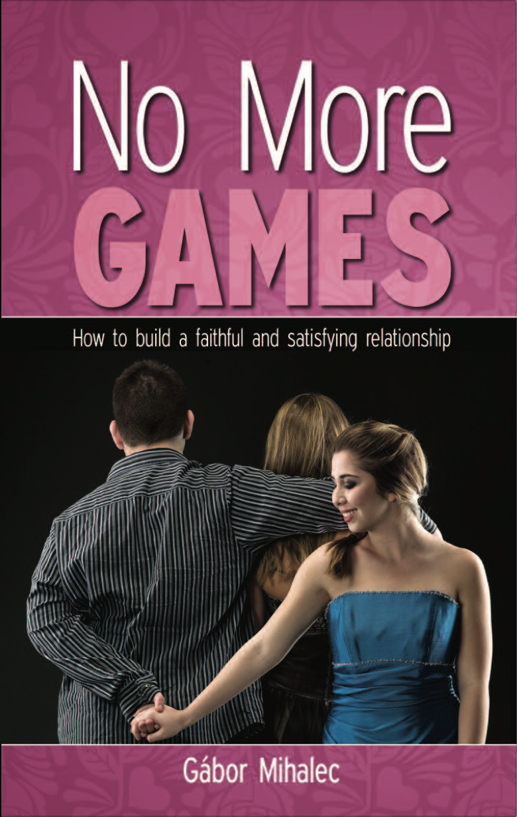
Book recommendation:
No More Games: How to build a faithful and satisfying relationship (Autumn House, 2018)
By: Gabor Mihalec

Slide 28
Blessings as you work towards deepening the level of intimacy in your marriage.

